Slide 1


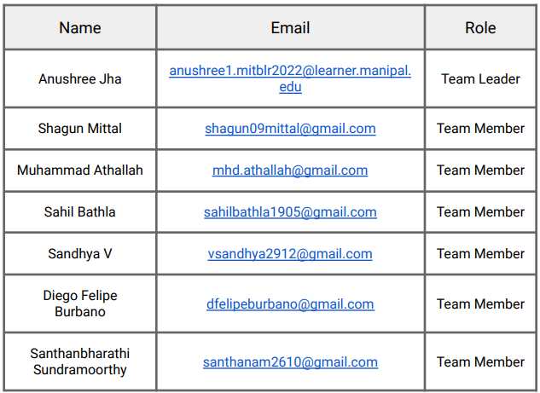
Project Report on
GeoInsight:
“Unveiling Location Clues for Enhanced Intelligence”
University of Auckland Micro Internship
(July 3rd – Aug 5th 2023)
(Team #7)
Mentor: David Valencia Redrovan

Slide 2
Presentation Outline
Introduction
Project Scope & Deliverables
Project Objectives & Favorable Business Outcome
Project Timeline
Project Outcomes
    Text Recognition Improvement
    Environment Recognition Improvement
    Location Support Expansion
Conclusion & Recommendation

Slide 3
Introduction
Signal—a trailblazing New Zealand-owned company—delivers state-of-the-art software and intelligence solutions through their mastery of open-source intelligence (OSINT).
Signal’s innovative SaaS platform empowers clients by harnessing the immense power of OSINT to bolster their security infrastructure. By adeptly gathering and consolidating vast online data, the platform offers real-time insights and vital alerts, helping clients effectively identify and counter threats. One primary goal of this venture is to boost preparedness for security challenges.
Signal's advanced platform enables clients to proactively monitor potential risks in real-time, taking a revolutionary approach to security management. Prompt alerts on potential hazards empower users to act decisively, mitigating risks and protecting their valuable assets.
In this project, the team is striving to tackle a critical business challenge: enhancing Signal's current model for location extraction and Named Entity Recognition (NER) from open-source intelligence (OSINT) data.

Slide 4
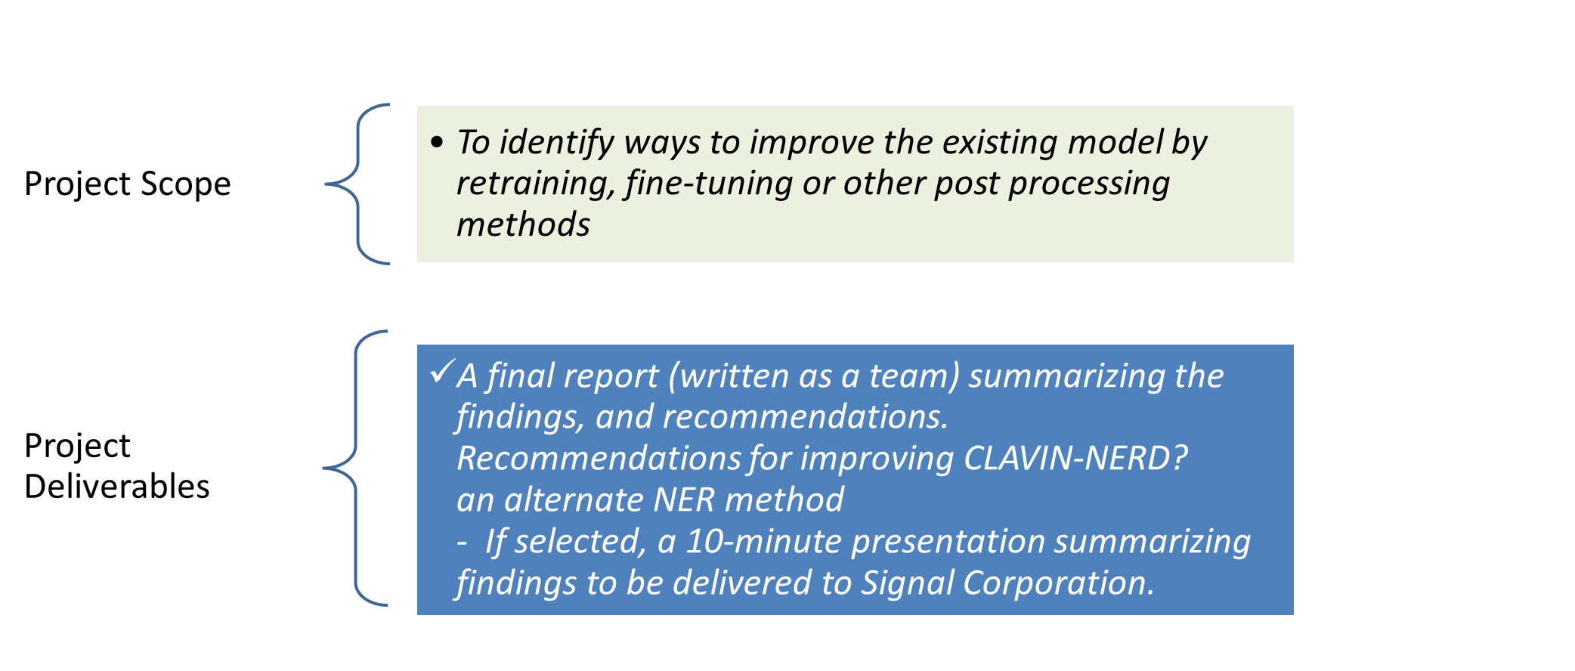
Project Scope & Deliverables

Slide 5
Project Objectives & Favorable Business Outcome
Project objectives:
To boost the precision and efficacy of pinpointing locations and relevant entities within textual data processed by Signal's platform.
Addressing this challenge is crucial for Signal, as the accuracy and dependability of location extraction directly influence the effectiveness of their OSINT platform.
By providing vital security intelligence to clients worldwide, the capacity to accurately identify locations, street addresses, points of interest, and other entities is imperative for timely detection and response to possible security threats.
Favorable Business Outcome:
Elevate the value and usefulness of its SaaS platform, cementing its reputation as a top-tier provider of OSINT solutions.
Empowering Decision-Making: Accurate and specific location extraction.
Minimizing False Positives/Negatives: Enhancing the model's capability to recognize unusual text structures and differentiate between similarly named entities reduces false positives and negatives.
Expanding Global Relevance: As Signal's clients operate worldwide, recognizing non-Euro-centric locations enhances platform inclusivity and value for clients across the globe. Facilitating In-Depth Analysis: The hierarchical location entity provided by the model allows users to examine data at various geographical levels, revealing more profound insights into potential threats and patterns. Maintaining Competitive Advantage: In a fast-paced and competitive landscape, maintaining cutting-edge technology is vital for Signal's success.
strategically important for Signal's growth and reputation in the global OSINT landscape.
By refining its location extraction and NER capabilities, Signal can provide enhanced security intelligence, bolster client confidence, and solidify its position as a leading provider of software and intelligence services for both the public and private sectors. As demand for next-gen security solutions escalates, Signal’s dedication to excellence solidifies its position as an OSINT industry leader.

Slide 6
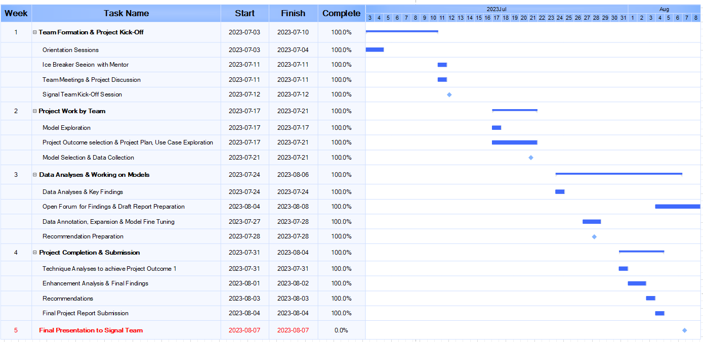
Project Timeline

Slide 7
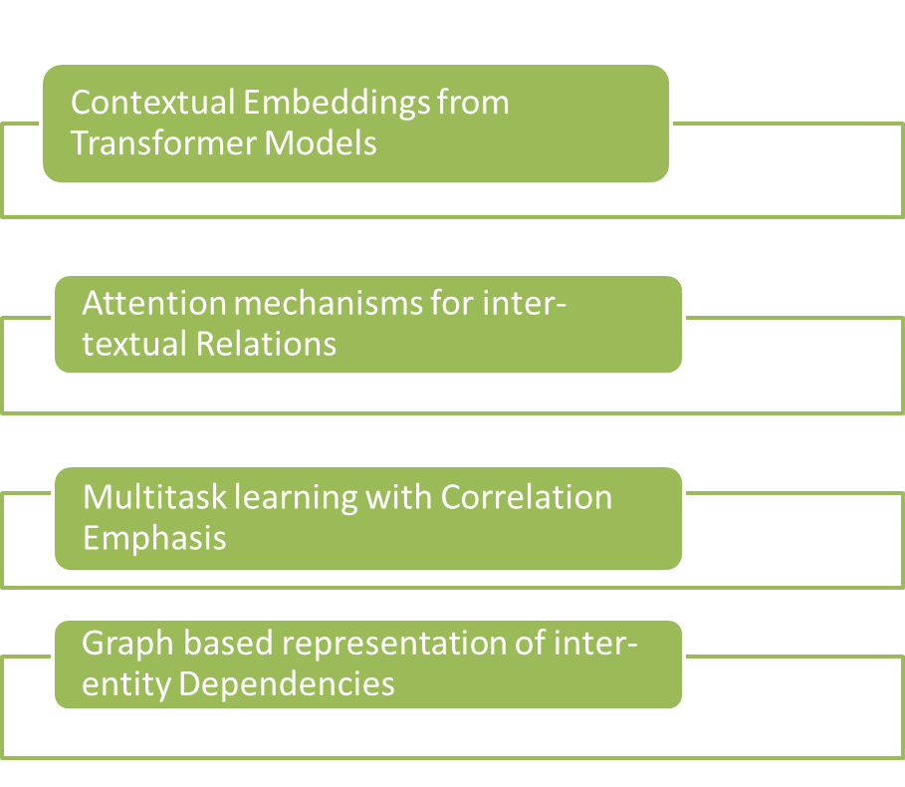
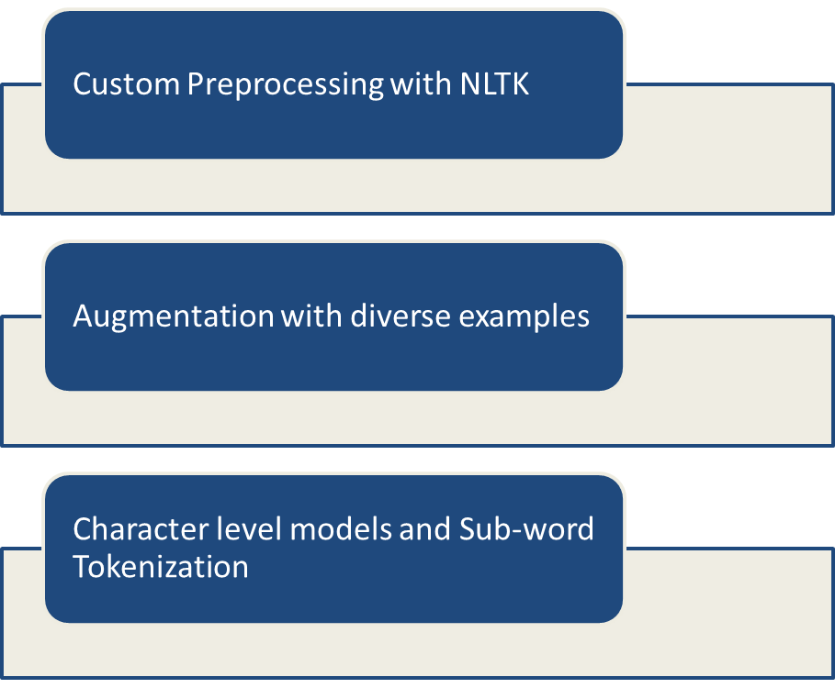
Project Outcome – Text Improvement Recognition
Goal # 1
Improving Atypical Text Structure Recognition:
Goal # 2
Enhancing Correlation Support for Multiple Input Texts:
(Devlin et al 20AA)
(Smith et al 20XX)
(Vaswani et al 20BB)
(Chen & Liu 20YY)
(Rudder 20CC)
(Luong & Manning 20ZZ)
(Hamilton et al 20DD)

Slide 8
Project Outcome – Environment Improvement Recognition
BERT implementation in CALVIN-NERD
Goal | Recommendations
Improve accuracy by recognizing specific street addresses mentioned in the text. | Contextual Embeddings: Data Pre-processing Fine Tuning Model Integration & Evaluation Deployment of CALVIN-NERD
Recognize and map textual references to points of interest accurately | Entity gazetteers: GeoNames: DBpedia: WordNet: Freebase OpenStreetMap (OSM): U.S. Census Bureau’s Gazetteer
Refine forms of identification to better distinguish between ambiguous locations and similarly named entities | Ensemble Models: Combining inputs from multiple NER model

Slide 9
Project Outcome – Location Support Expansion
Goal | Recommendations
Endorse dataset expansion to recognise more non-euro-centric locations. | Additional Gazetteers and Knowledge Graphs Integrating external resources into NLP
Enhance the model to handle the correlation of multiple input texts for better location support expansion. | Contextual Word Embeddings ability to capture content and semantics effectively
 | Custom Entities: recognize general entities such as people, locations, organizations etc
 | Ensemble Models: combine multiple geo-tagging techniques and external data sources enable the model to effectively handle different types of location
 | Cross-lingual Transfer Learning:

Slide 10
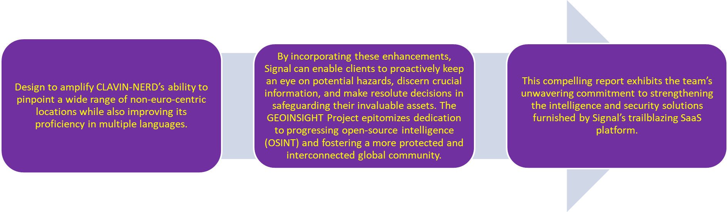
Conclusion & Recommendations
To elevate Text Recognition, the Team#7 recommends managing multiple input texts to ensure better correlation with use cases and brought forward procedures to bolster atypical text processing. They recommended custom preprocessing, data augmentation, and character-level models to adeptly tackle intricate text structures.
Regarding Environment Recognition Enhancement, the Team recommends to sharpen the accuracy in identifying specific street addresses and points of interest cited in texts. They presented various creative concepts like employing standardized address formats, real-time trends, geolocation data, and contextual word embeddings.
In a bid to Extend Location Support, the Team recommends various tactics such as incorporating extra gazetteers and knowledge graphs, contextual word embeddings, tailored entities, ensemble models, and cross-lingual transfer learning.

Slide 11
Thank You!
Kia Ora

Slide 12
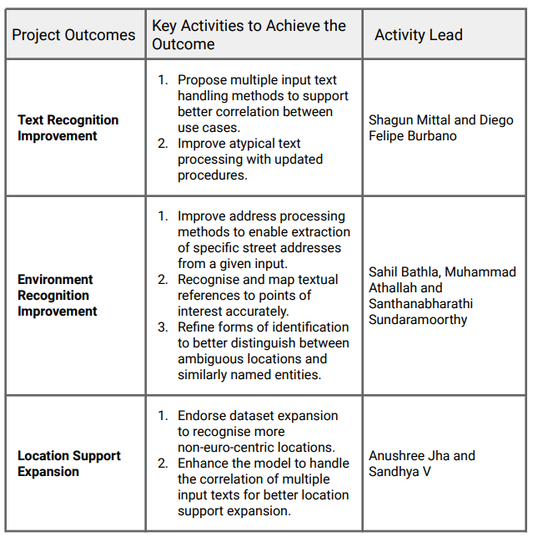
Project Scope & Deliverables

